Slide 1




AlignedNorm: Prompting Vision–Language Models via Coupled Prompt Field
Qi Ma^{1,2}, Chen-Yang Wang^{1,2}, Dehong Gao³, Deng-Ping Fan^{1,2,4†}
¹VCIP & CS, Nankai University
²NKIARI, Shenzhen Futian
³Northwestern Polytechnical University
⁴SLAI
† Corresponding Author
The 43th International Conference on Machine Learning (ICML 2026)

Slide 2




Prompt Learning for VLMs
Text
Encoder
Image Encoder

Slide 3
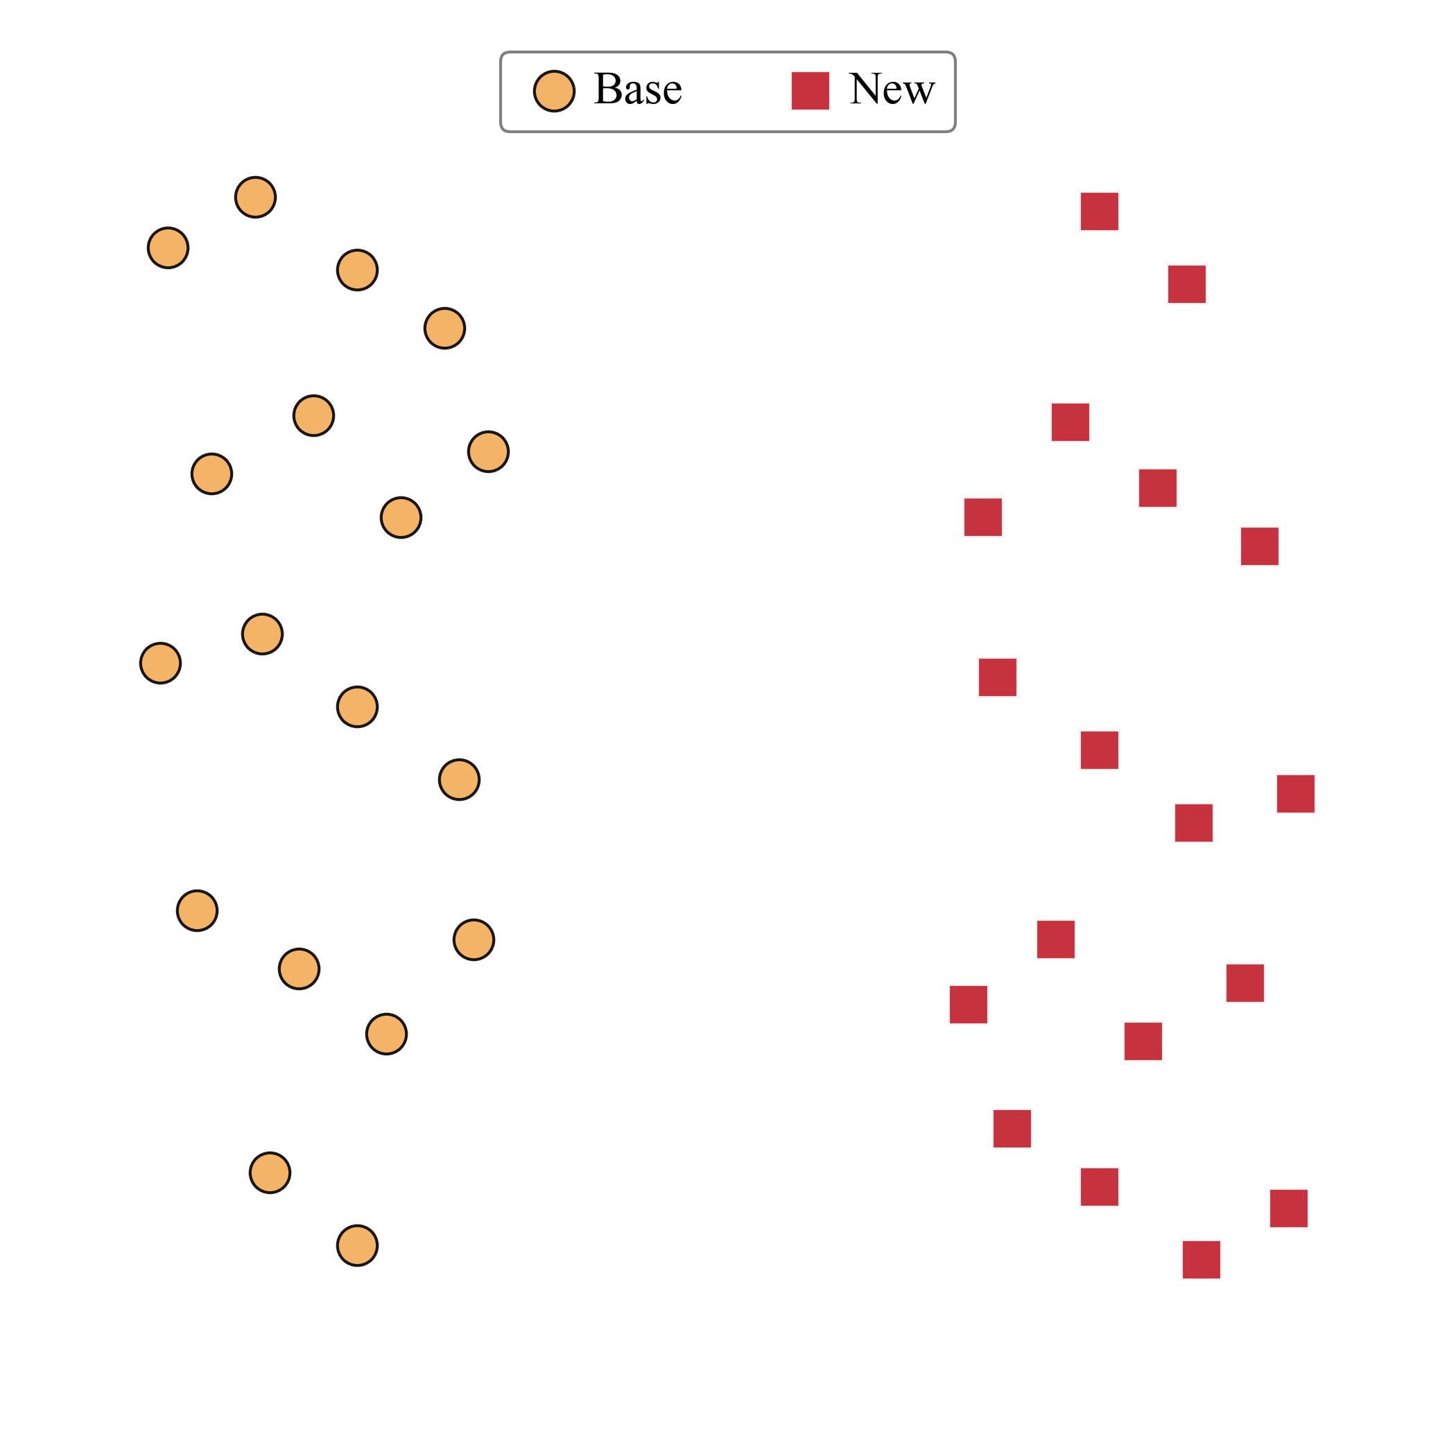
Prompt Learning for VLMs
Initial State of Features

Slide 4
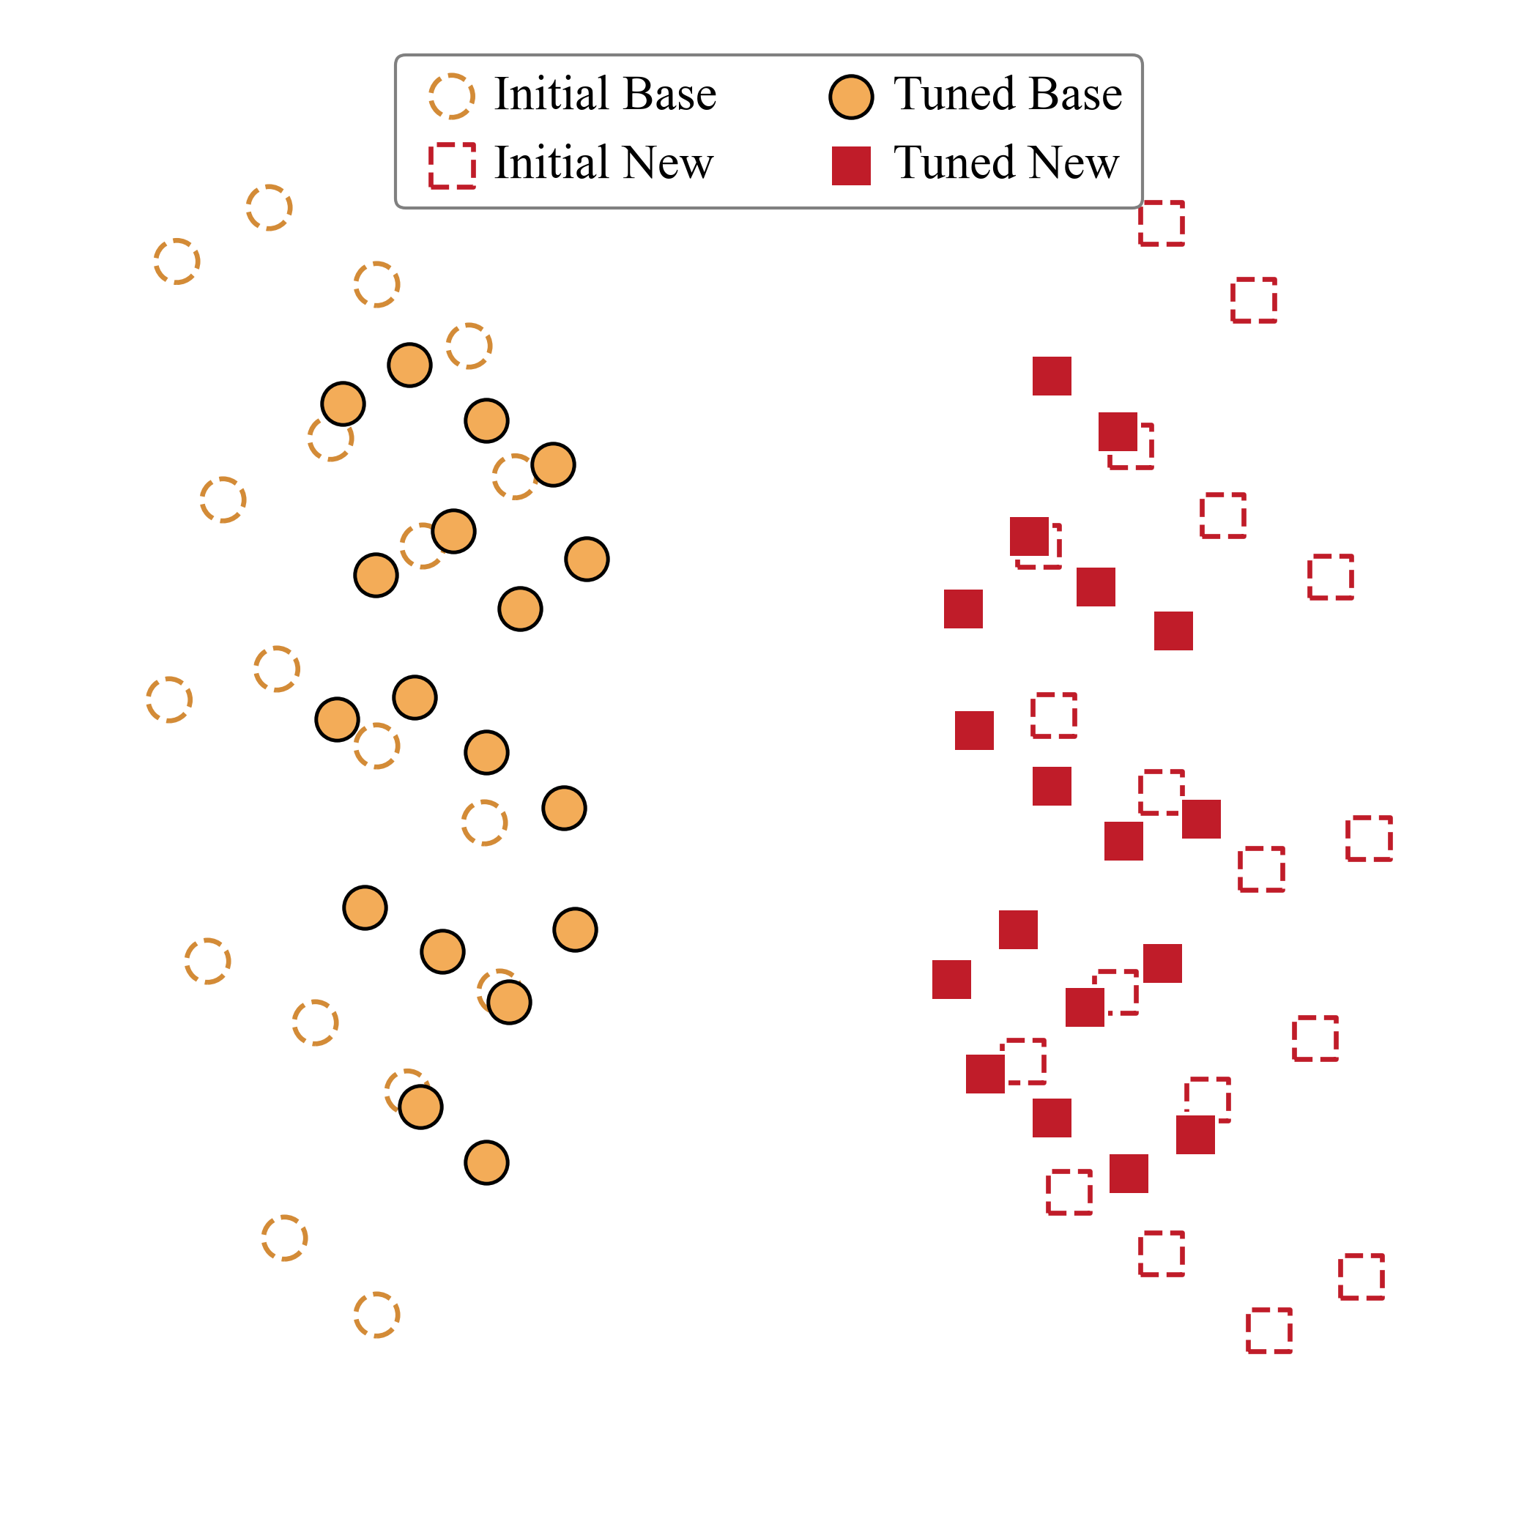
Prompt Learning for VLMs
Initial State of Features
After Prompt Learning
Prompt learning drives a global shift in the pretrained feature space.
The learned prompts guide model representations to move toward task-relevant semantics.

Slide 5
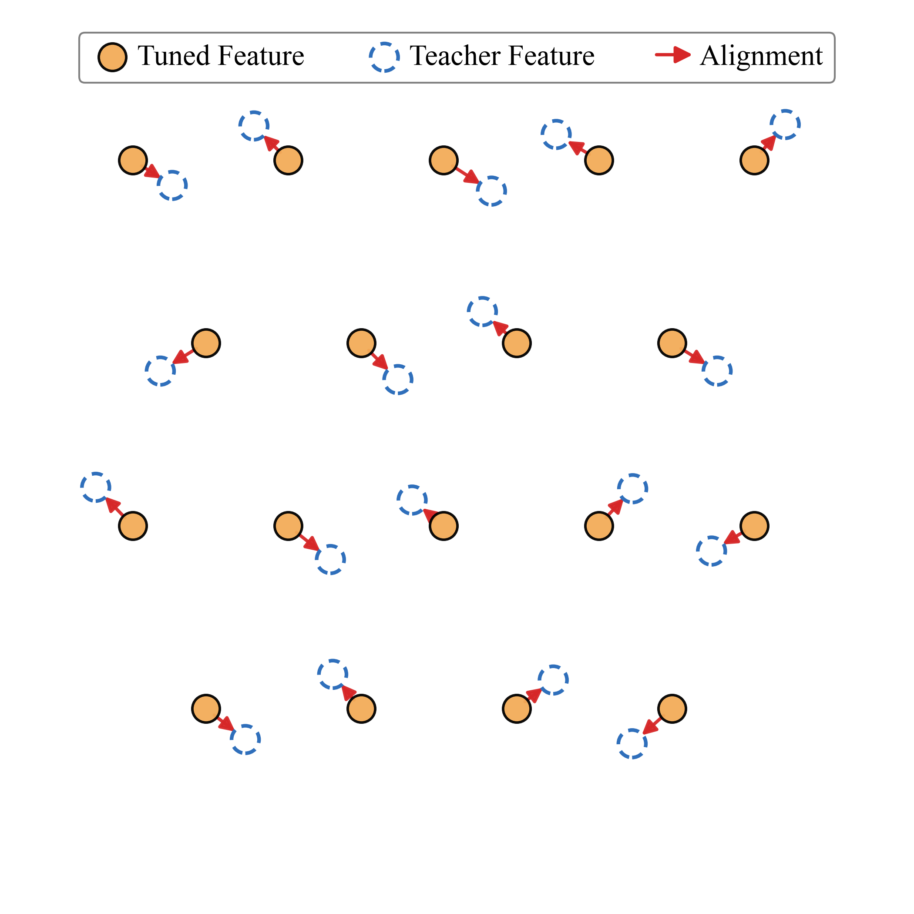
Base-New Tradeoff Dilemma
End-to-End Prompt Learning
Alignment to Predefined Teacher Embeddings:
Origin Embeddings
Preserve knowledge from the original VLMs
External Teacher
Mimic stronger teacher models or external anchors
Gaussian / Uncertainty Distribution
Relax over-confident predictions with softened targets

Slide 6
Base-New Tradeoff Dilemma
End-to-End Prompt Learning
Alignment to Predefined Teacher Embeddings:
Origin Embeddings
Preserve knowledge from the original VLMs
External Teacher
Mimic stronger teacher models or external anchors
Gaussian / Uncertainty Distribution
Relax over-confident predictions with softened targets
Teacher-dependent Upper Bound
The adapted model is highly dependent on the quality of the predefined target.
Unavailable Ideal Teacher
Reliable stronger teachers are not always available in real-world scenarios

Slide 7
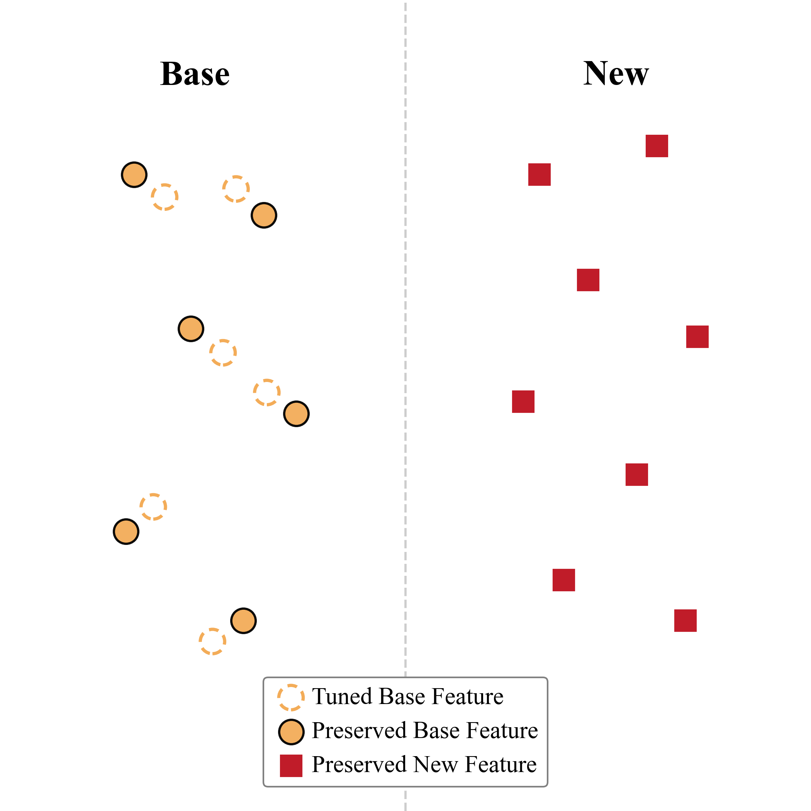
Base-New Tradeoff Dilemma
Decoupled Prompt Learning
Isolate task-specific knowledge in separate spaces:
Subnetwork Isolation
Separate knowledge by an auxiliary subnetwork
Prompt Isolation
Separate knowledge by different prompts
Representation Isolation
Separate knowledge by distinct representation spaces

Slide 8
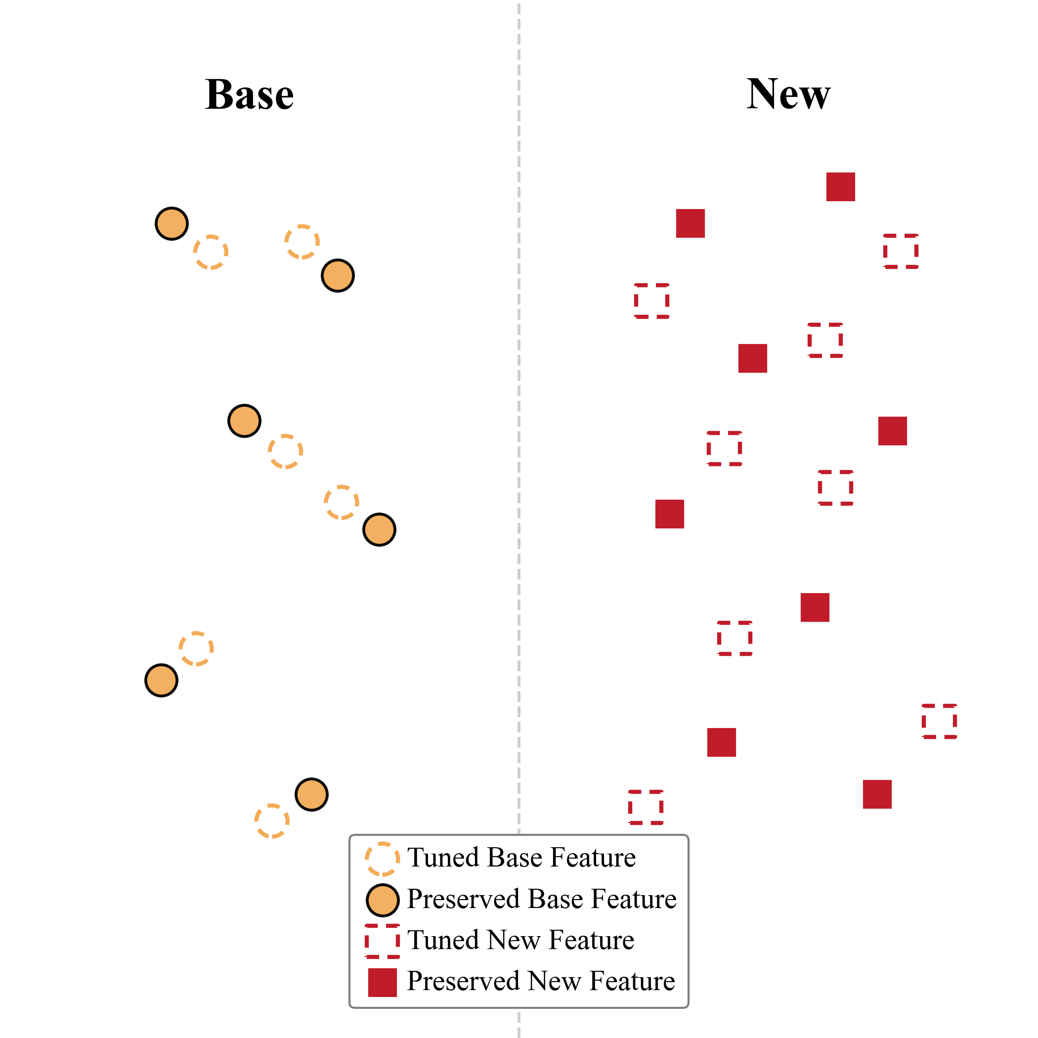
Base-New Tradeoff Dilemma
Decoupled Prompt Learning
Isolate task-specific knowledge in separate spaces:
Subnetwork Isolation
Separate knowledge by an auxiliary subnetwork
Prompt Isolation
Separate knowledge by different prompts
Representation Isolation
Separate knowledge by distinct representation spaces
Task-identity Dependency
The model needs prior knowledge of whether the current task is base or new.
Weak Base-New Coupling
solated spaces preserve knowledge but limit mutual constraints between Base and New semantics

Slide 9
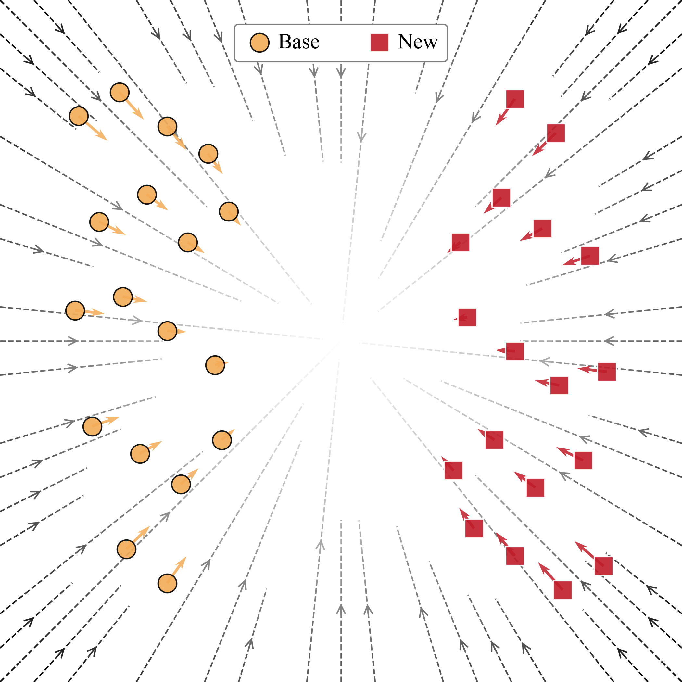
Prompt Learning as a Field
Initial State of Features
After Prompt Learning
Prompt Field
This shift can be interpreted as a prompt-induced transformation field over the feature space
The Prompt Field provides a structured view to understand how the model changes
Modeling feature shifts is more reliable than defining ideal feature targets

Slide 10
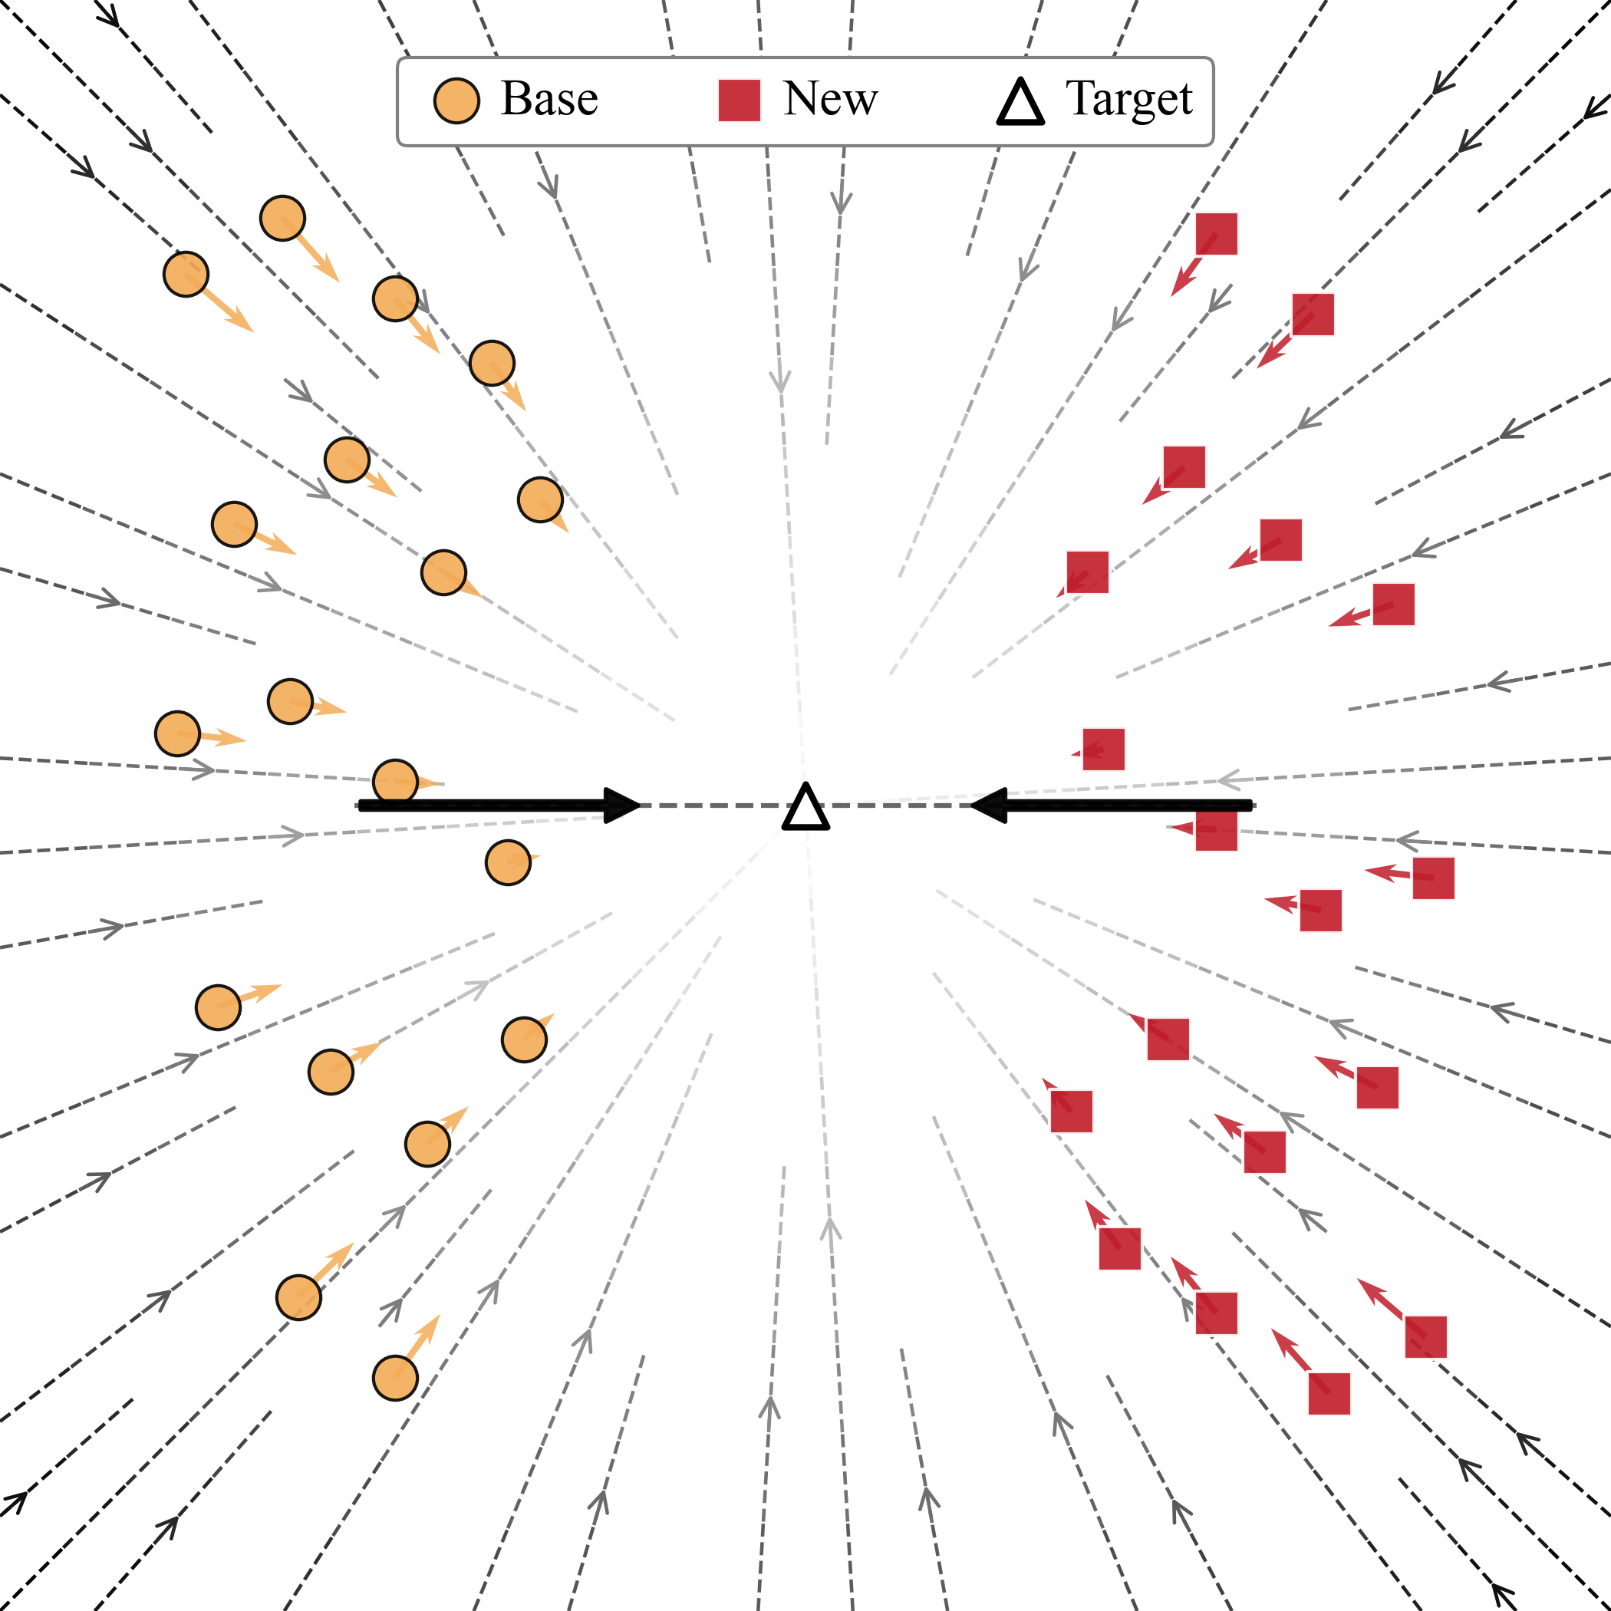
Prompt Learning as a Field
Ideal Optimization

Slide 11
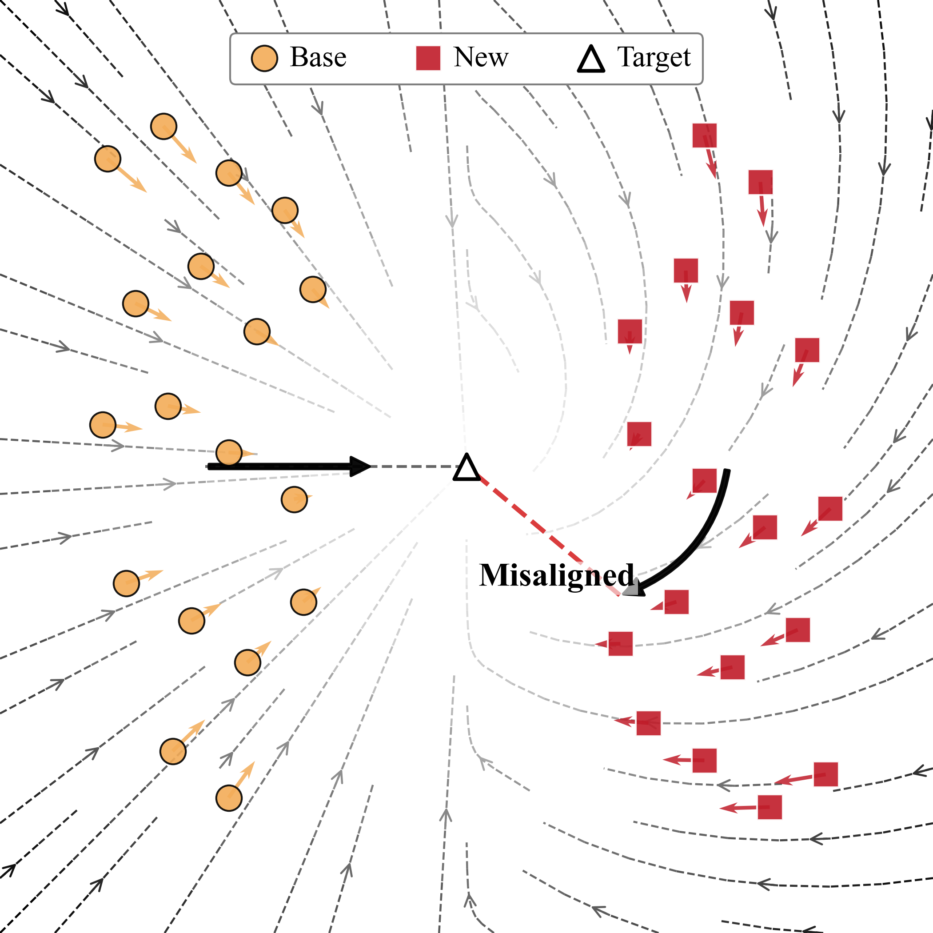
Prompt Learning as a Field
Ideal Optimization
Isolated Optimization

Slide 12
Prompt Learning as a Field
Ideal Optimization
Isolated Optimization
Why does adaptation to Base tasks compromise generalization to New ones?

Slide 13
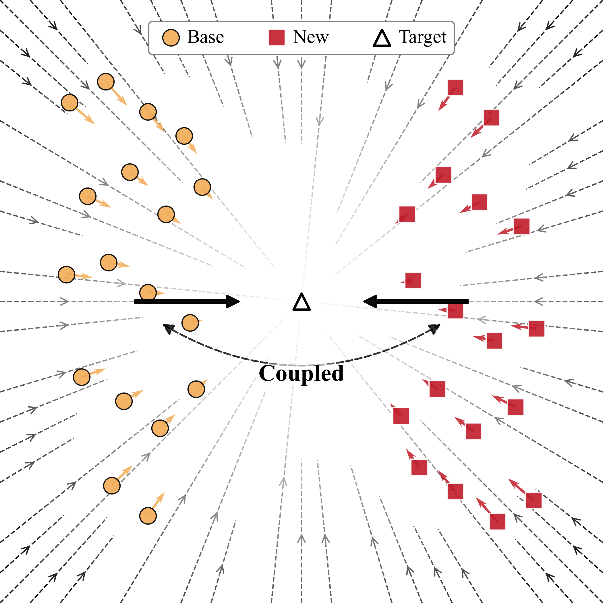
Coupled Prompt Field
Coupled Prompt Field
A shared prompt field couples base and new tasks:
Field Consistency
Keep consistent correction strength across Base and New
Uniform Field Updates
Balanced optimization strength across samples
Perturbation Robustness
Stable field behavior under stochastic noise

Slide 14
Coupled Prompt Field
Coupled Prompt Field
A shared prompt field couples base and new tasks:
Field Consistency
Keep consistent correction strength across Base and New
Uniform Field Updates
Balanced optimization strength across samples
Perturbation Robustness
Stable field behavior under stochastic noise
What is essential for constructing such a coupled field?

Slide 15
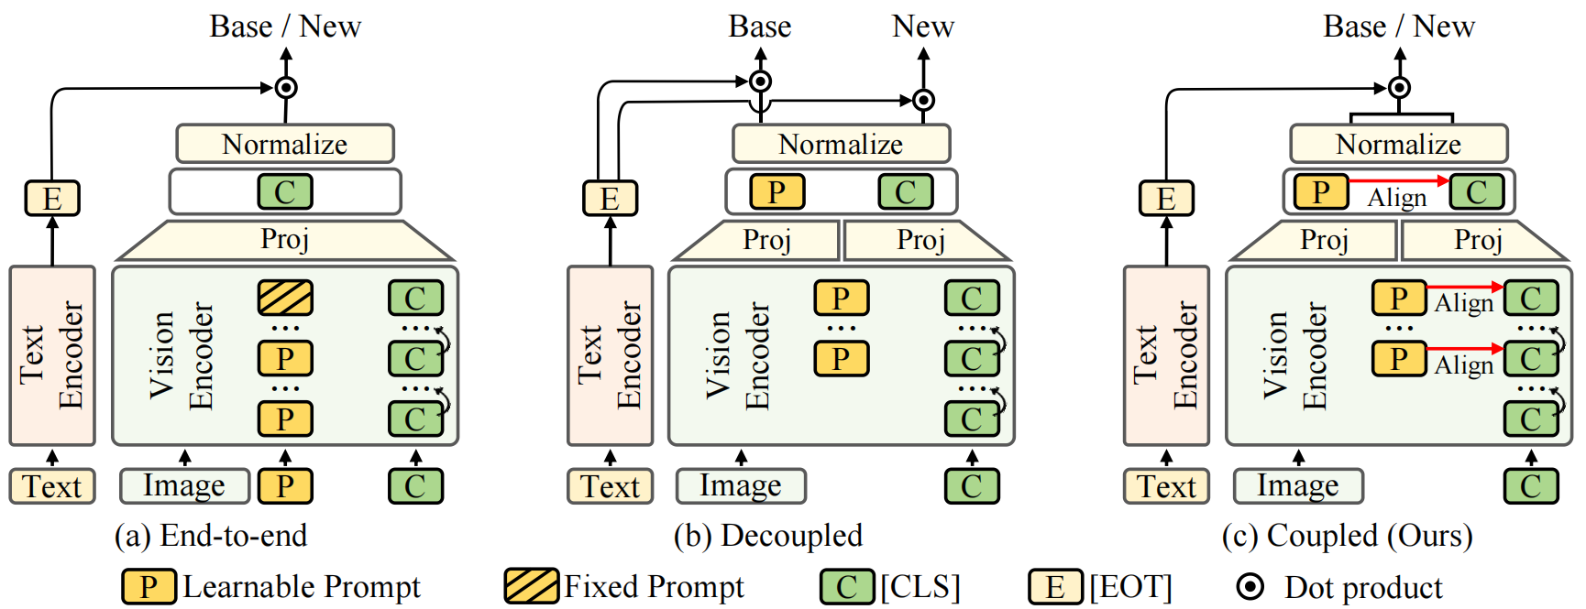
Methodology: AlignedNorm on Projection Layers in Decoupled Methods
Our core idea: prompt–[CLS] norm alignment on projection layer is critical for coupling:
Stabilizes field intensity, balances update dynamics, and improves perturbation robustness
Norms are easy to compute and do not rely on large-batch statistics

Slide 16
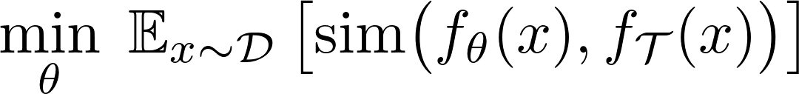

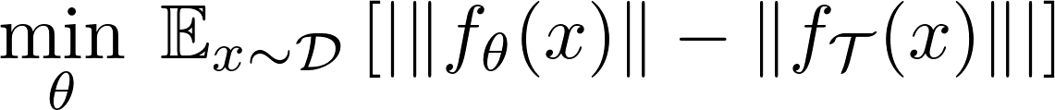

Methodology: AlignedNorm on Projection Layers in Decoupled Methods
Conventional Practice (direction alignment)
Ours (norm alignment)
Our core idea: prompt–[CLS] norm alignment on projection layer is critical for coupling:
Stabilizes field intensity, balances update dynamics, and improves perturbation robustness
Norms are easy to compute and do not rely on large-batch statistics
It preserves relative feature relationships while keeping absolute semantic directions flexible

Slide 17
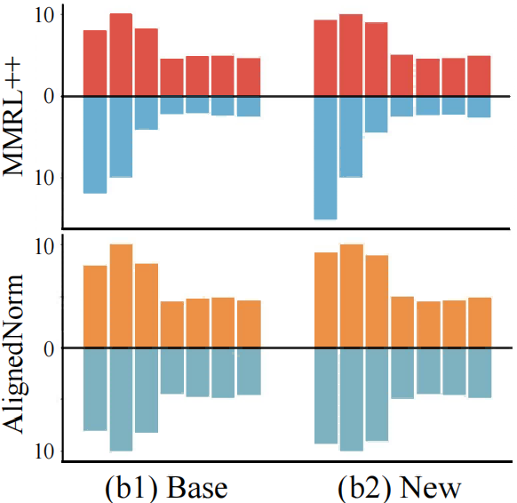
Methodology: AlignedNorm at each Prompted Layer in Decoupled Methods
Norm
Norm
Layer
Layer
Our core idea: prompt–[CLS] norm alignment at each prompted layer is critical for coupling

Slide 18
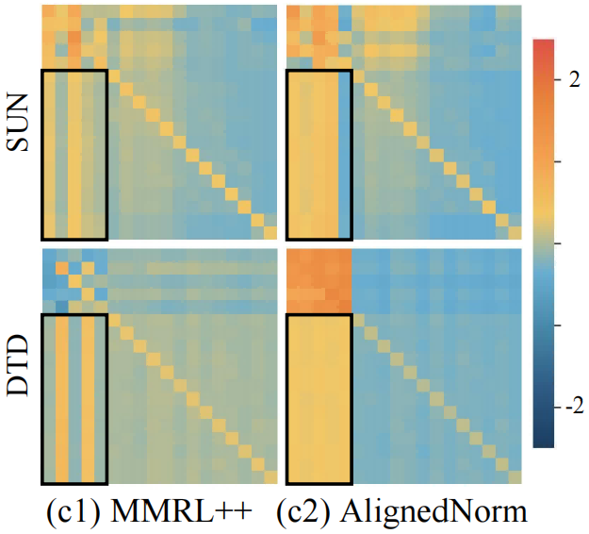
Methodology: AlignedNorm at each Prompted Layer in Decoupled Methods
Norm
Norm
Layer
Layer
Our core idea: prompt–[CLS] norm alignment at each prompted layer is critical for coupling:
Layer-wise alignment keeps prompt tokens visible to global tokens during intermediate attention
Controlling prompt-token scales inside the encoder stabilizes intermediate prompt dynamics
Properly scaled attention logits prevent prompt tokens from being ignored during optimization

Slide 19
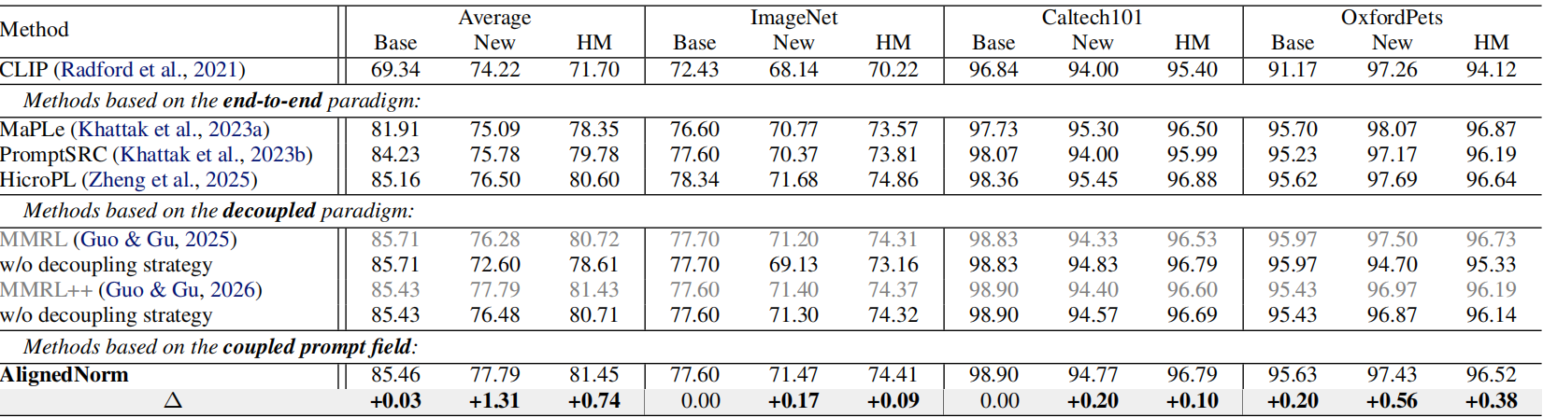
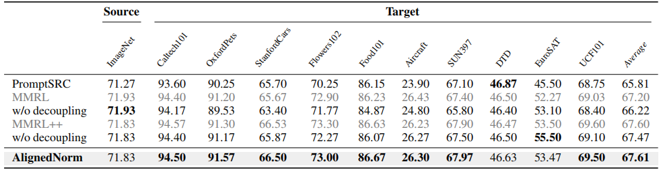
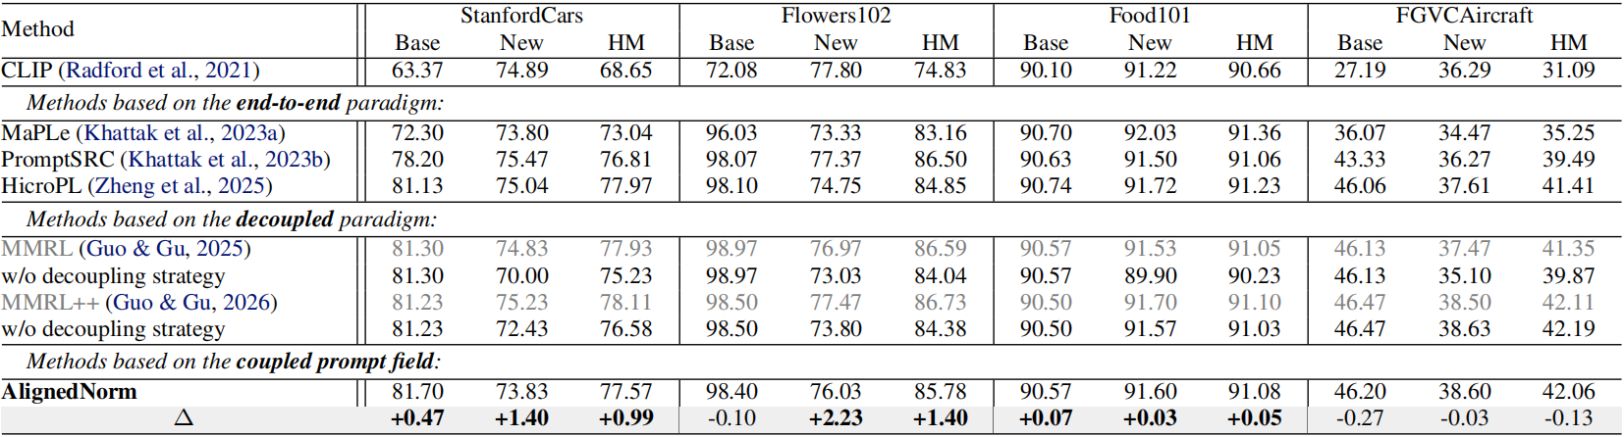
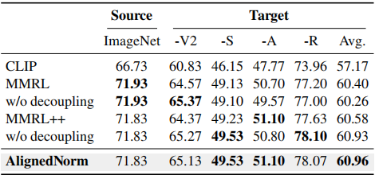
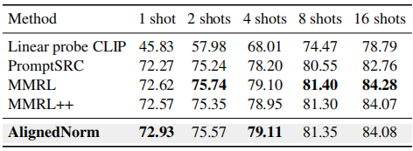
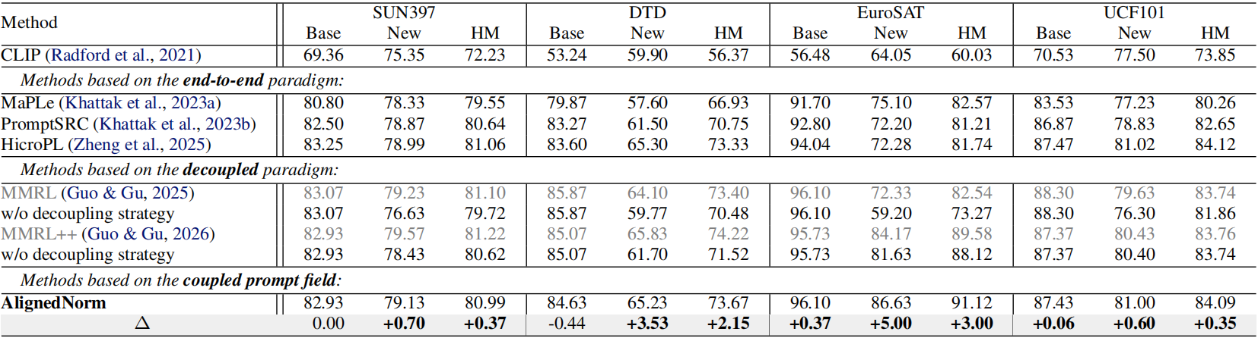
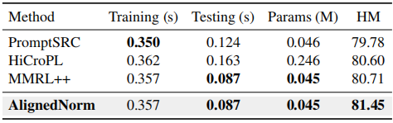
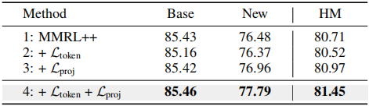
Main Results
Cross-Dataset Benchmark Evaluation
Domain Generalization
Few-shot Learning
Base to new generalization experiment
Computation Overhead
Components Ablations
Without external knowledge distillation or decoupled inference

Slide 20
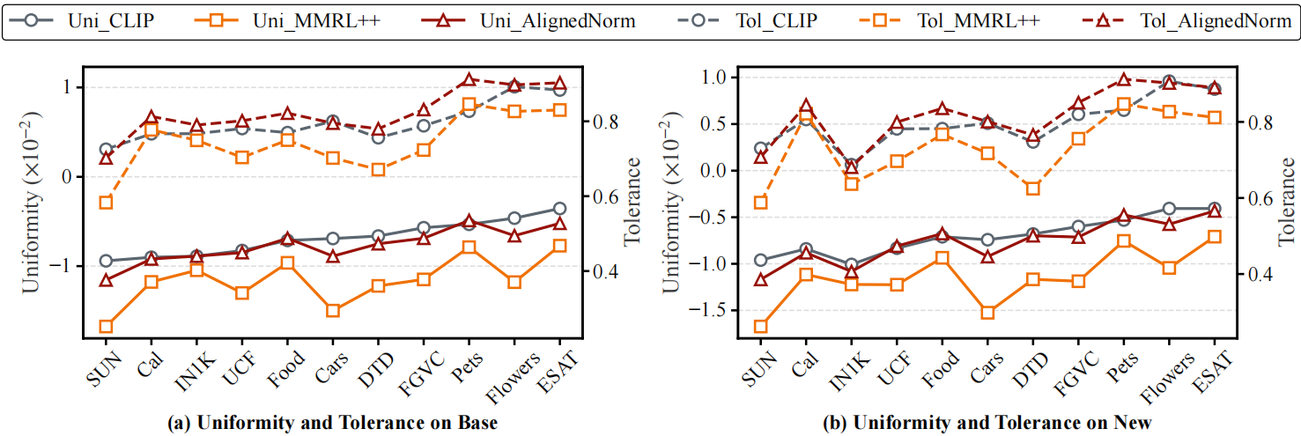
Geometry Consistency
Key Takeaways from Uniformity and Tolerance:
Simple norm alignment stabilizes the representation geometry and couples the prompt field
Norm alignment preserves relative geometry without forcing absolute direction alignment
What matters is not where features are located, but how they are relatively organized

Slide 21
Thank you for listening！
All resources are open-source
Paper: https://openreview.net/forum?id=aQAWAtrxxe
Code: https://github.com/QByteM/AlignedNorm
Email: nkucsmq@gmail.com
Feel free to reach out for discussions and collaborations

